Slide 1
MIND: In-Network Memory Management for Disaggregated Data Centers
Seung-seob Lee, Yanpeng Yu, Yupeng Tang, Anurag Khandelwal, Lin Zhong, Abhishek Bhattacharjee
Yale University

Slide 2
Resource Disaggregation
Idle
CPU
CPU
CPU
Network
CPU
MEM
GPU
MEM
GPU
CPU
MEM
GPU
CPU
MEM
GPU
MEM
MEM
GPU
GPU
[servers]
[disaggregated blades]
Benefits of resource disaggregation
High resource utilization
Easy to manage (modularity)
Elastic scalability
New task

Slide 3


Memory Disaggregation
Need for memory disaggregation
Timely problem
Faster & harder to disaggregate
Low utilization
(as low as 30%)
Storage (NVMe SSD)
Network
Memory (DDR4)
L3 cache
Unbalanced usage
(> 70% of the time in clusters)
5 GB/s (PCIe 4.0)
25 GB/s (PCIe 4.0)
25.6 GB/s (per channel)
370 GB/s
Data rate
Latency
Energy consumption
(up to 46% of avg. system)
45 / 450 us (R/W)
~5 us (4KB)
<50 ns
11 ns
Storage disaggregation is already popular

Slide 4
Memory Disaggregation Goals
Performance (CPU ↔ memory): high throughput & low latency
Transparent elasticity: flexible resource allocation
T5
High throughput, low latency
T1
Alloc6
CPU
Memory
Alloc1
T4
Alloc5
T2
Network
Alloc3
CPU
Memory
T6
Alloc4
T3
CPU
Memory
Alloc2
[disaggregated blades]

Slide 5
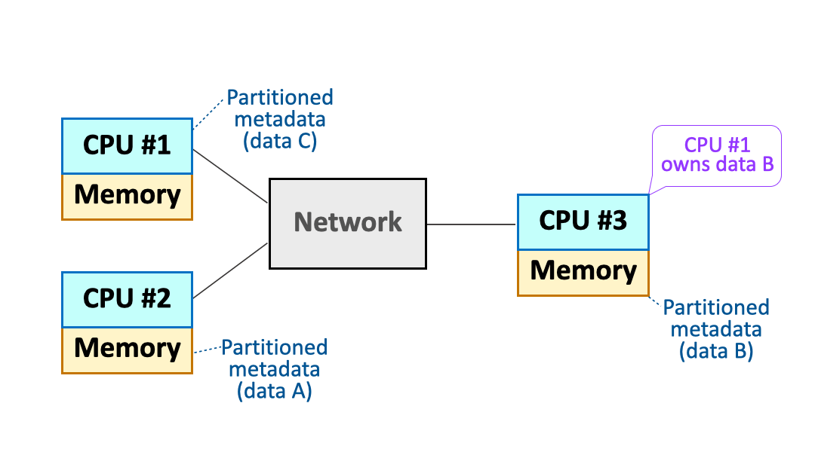
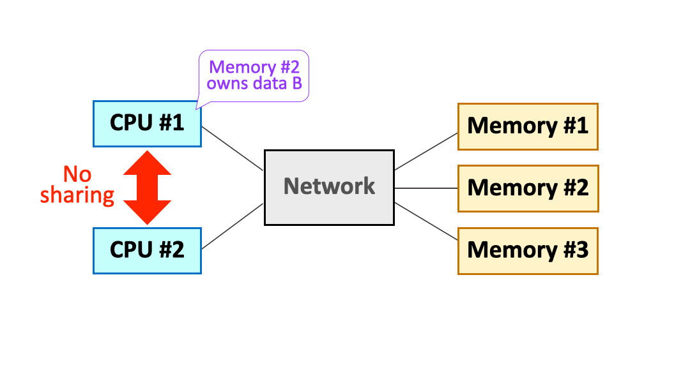
Existing Approaches
Distributed shared memory (DSM)
Recent disaggregated memory schemes
DSM
Ideal
Transparent elasticity
Recent Disagg.
Performance

Slide 6
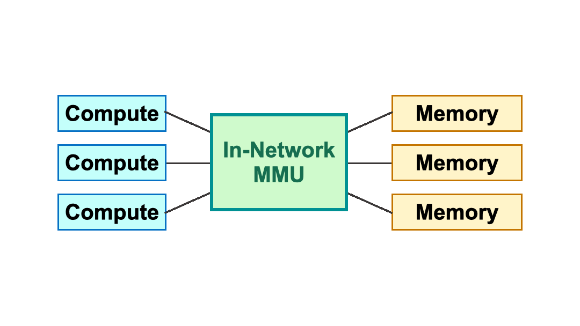
Key Insight — In-network Memory management
Central location: global view & processing directly in the data path
Programmable switching ASIC: flexible processing at line rate
Similarity between network functions and memory management
Networking Memory management
Programmable & running @line-rate
IP forwarding
IP assignment
Access control
Multicast/broadcast
Address translation
Memory allocation
Memory protection
Cache invalidations
Compute blades (disaggregated)
Memory blades (disaggregated)

Slide 7
MIND: In-network Memory Management
Cache coherence protocol: how to keep data synchronized?
?
Programmable switch
CPU
Memory
Control plane
Read, 0x1000
CPU
Data plane
Address translation: where is the data?
X
CPU
Memory
Memory protection:
Is this access permitted or valid?

Slide 8
Challenges in Building In-network MMU
Limited amount of in-network resources
Limited size of in-network memory
Tens of MB → not sufficient to store metadata in a traditional way
E.g., page table: 4 KB for 4GB of memory → 1M entries
Limited computation capability
Switching ASIC → not sufficient to directly port traditional MMU functions
E.g., limited number of operations for line rate processing ↔ complicated cache coherence protocol

Slide 9
3 Principles for System Design
P1 - Decouple memory management functionalities
→ Each function has the data structure suitable to its purpose
P2 - Leverage global view of network
→ Make better decisions for memory management
P3 - Exploit network-centric hardware primitives
→ Reuse network hardware highly optimized for network functions

Slide 10
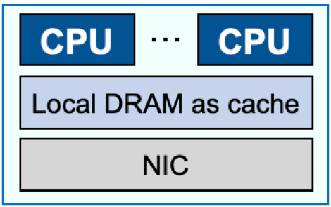
MIND overview: challenges and solutions
New access
CPU
…
CPU
Local DRAM as cache
Control plane
NIC
Memory allocation
Permission assignment
Directory entry allocation
MEM
MEM
MEM
MEM
NIC
NIC
Data plane
…
Cache
directory
Memory
protection
Address
translation
Memory blades
…
coherence
Compute blades
Programmable switch

Slide 11
MIND overview: challenges and solutions
New access
CPU
…
CPU
Static huge partition
Fine-grained range-based translation
Local DRAM as cache
Control plane
NIC
Memory allocation
Permission assignment
Directory entry allocation
MEM
MEM
MEM
MEM
NIC
4KB page: too many entries Huge page: load balancing
NIC
Data plane
…
Address
translation
Cache
directory
Memory
protection
Address
translation
Memory blades
…
Compute blades
Programmable switch

Slide 12
MIND overview: challenges and solutions
New access
CPU
…
CPU
Local DRAM as cache
Control plane
Memory allocation
VMA-granularity protection
NIC
Permission assignment
Directory entry allocation
MEM
MEM
MEM
MEM
NIC
4KB page: too many entries Huge page: inflexible protection
NIC
Data plane
…
Cache
directory
Memory
protection
Address
translation
Memory
protection
Memory blades
…
Compute blades
Programmable switch

Slide 13
MIND overview: challenges and solutions
New access
CPU
…
CPU
Access granularity
Coherence granularity
→ Dynamic resizing
Local DRAM as cache
Control plane
NIC
Memory allocation
Permission assignment
Directory entry allocation
MEM
MEM
*with theoretical bound of O(log2) overhead
MEM
MEM
NIC
Small cache line: too many entries Large cache line: false sharing
NIC
Data plane
…
Cache
directory
Memory
protection
Address
translation
Cache
directory
Memory blades
…
Compute blades
Programmable switch

Slide 14
MIND overview: challenges and solutions
New memory allocation
CPU
…
CPU
Local DRAM as cache
Control plane
Memory allocation
Permission assignment
Directory entry allocation
NIC
Memory allocation
Permission assignment
Directory entry allocation
MEM
MEM
MEM
MEM
NIC
NIC
Data plane
…
Cache
directory
Memory
protection
Address
translation
Memory blades
…
Compute blades
Programmable switch

Slide 15
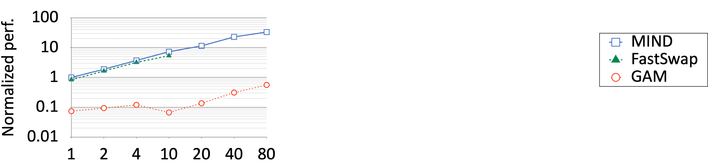
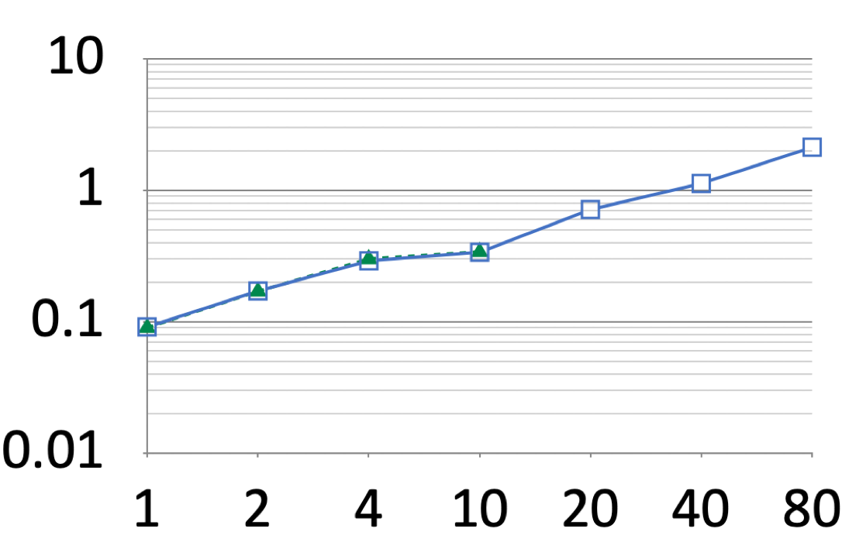
Performance Evaluation
Workloads with low contention
TensorFlow (ResNet50), YCSB workload C (read only)
TensorFlow (trace-based for GAM)
YCSB workload C (native)
MOPS
single blade
multiple blade
single blade
multiple blade
Number of threads

Slide 16
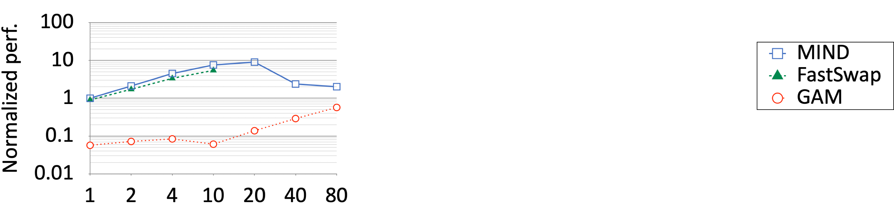
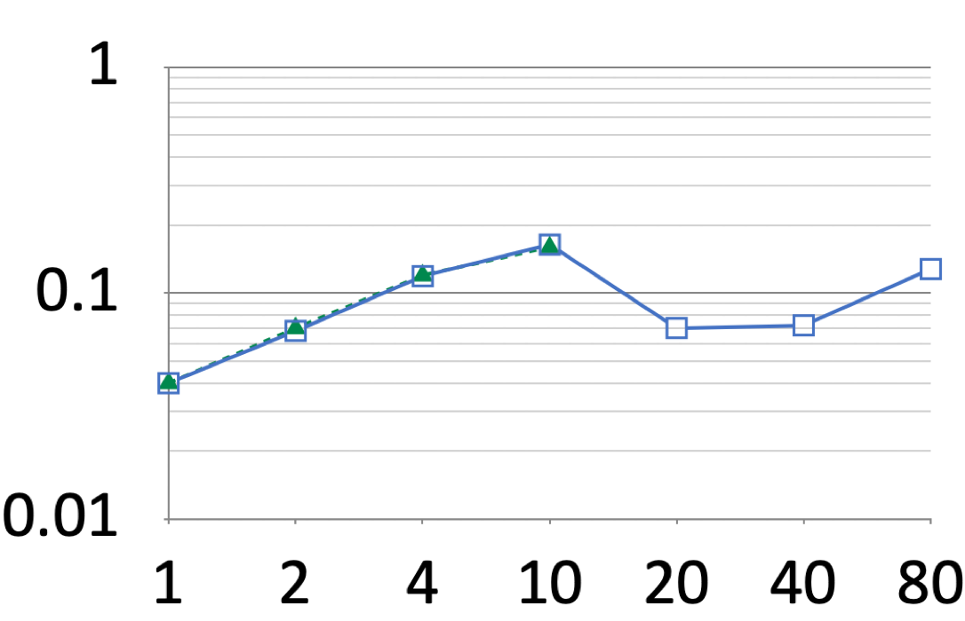
Performance Evaluation
Workloads with high contention
GraphChi (PageRank), YCSB workload A (50 % update, 50 % read)
GraphChi (trace-based for GAM)
YCSB workload A (native)
MOPS
single blade
multiple blade
single blade
multiple blade
Number of threads
Detailed trade offs for design choices in the paper!

Slide 17
Conclusion & Summary
Trade-off between resource elasticity and performance in memory disaggregation
We designed MIND, an in-network MMU by leveraging programmable network
Our prototype of MIND can match the performance of prior proposals and provide transparent elasticity

